Slide 1

Deep Learning -5.0
Instructor name: Shukdev datta
Ml developer at innovative skills

Slide 2
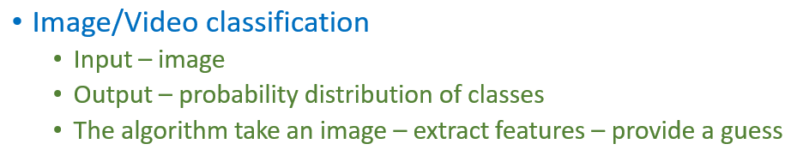
What Problems are CNNs good at?

Slide 3
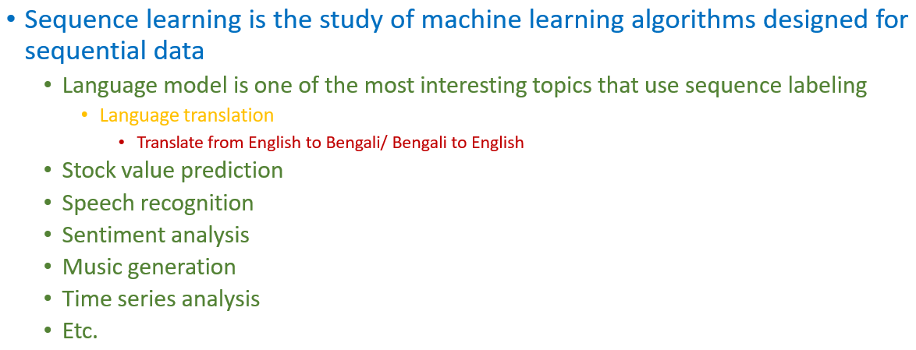
What is Sequence Learning?

Slide 4
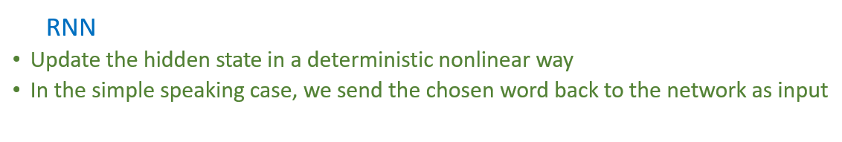
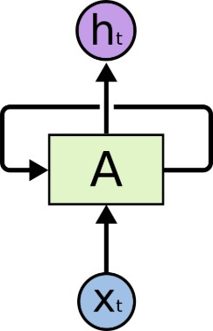
How to learn sequences?

Slide 5
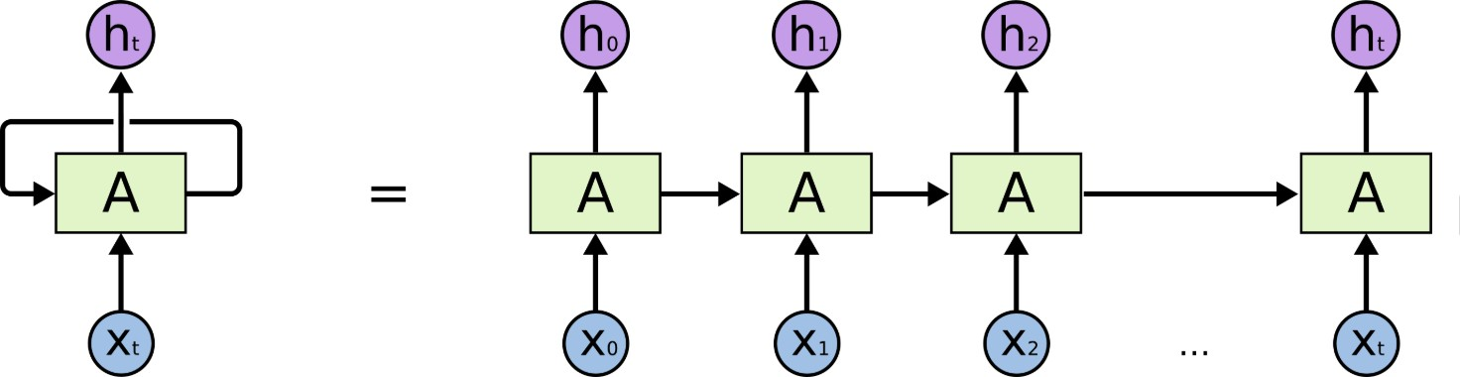
How does it look?

Slide 6
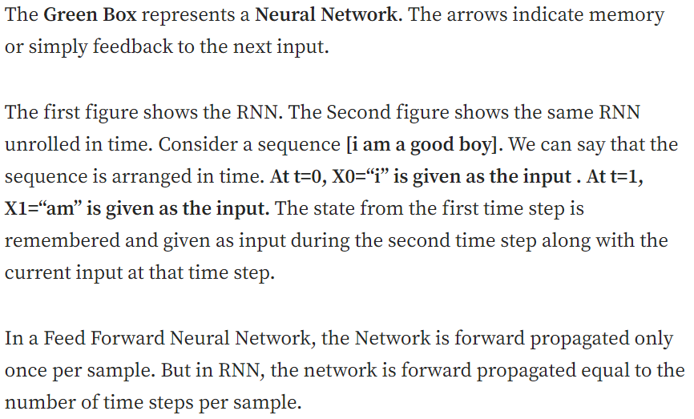
How does it look?

Slide 7
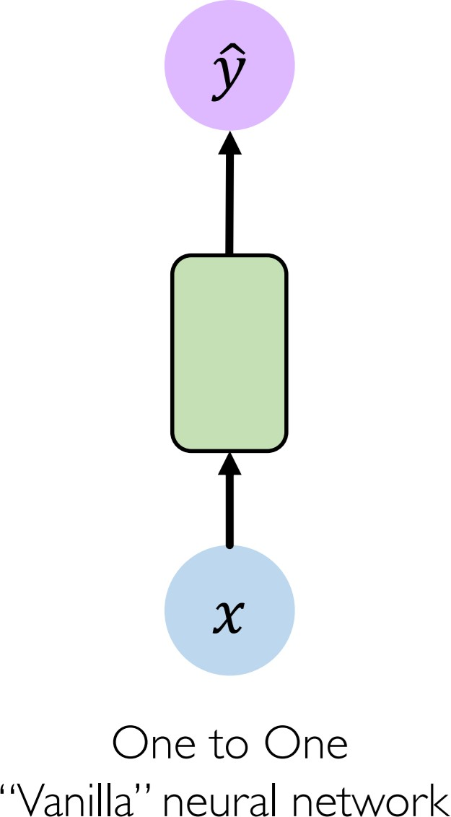
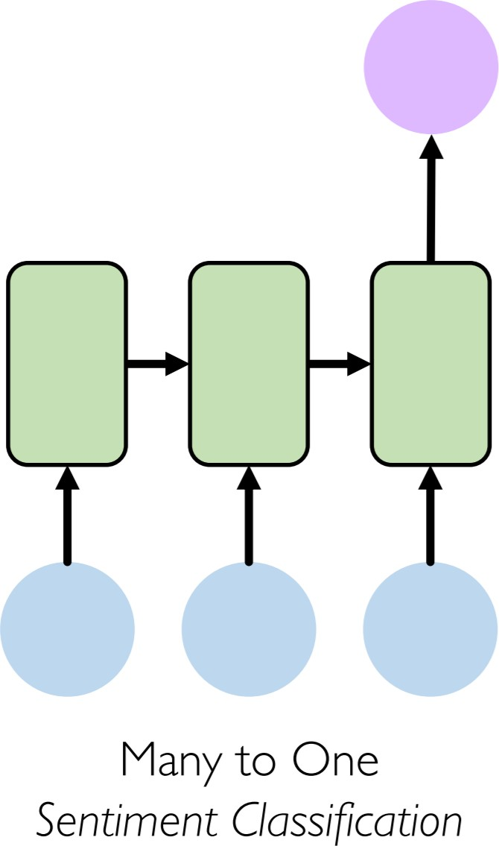
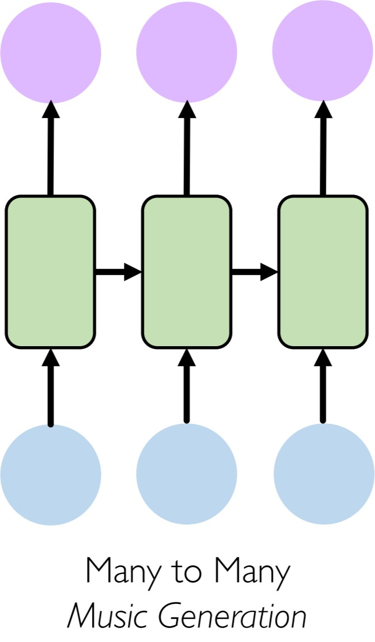
Types of RNN

Slide 8
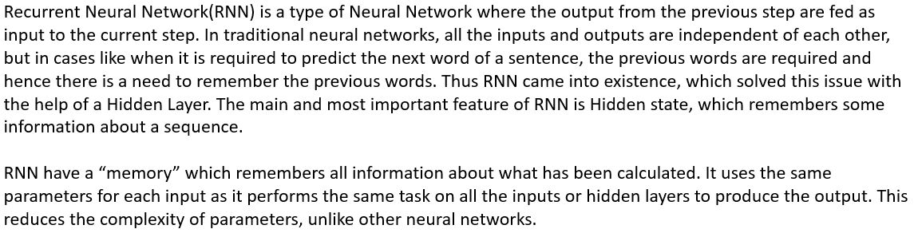
RNN Architecture

Slide 9
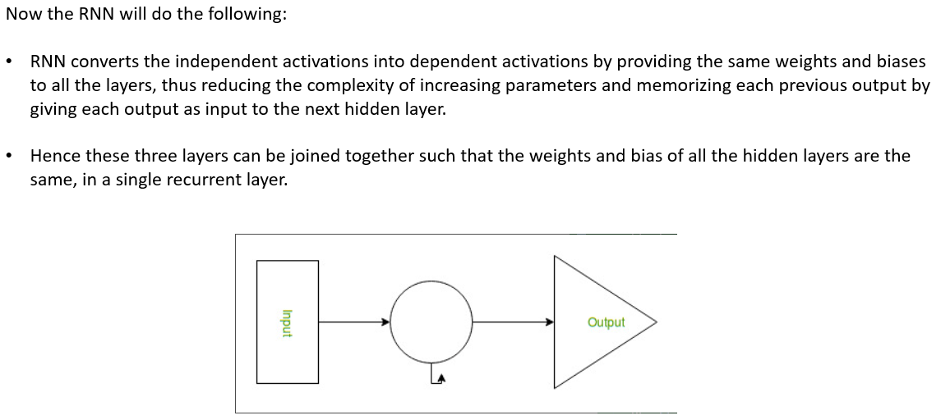
RNN Architecture

Slide 10
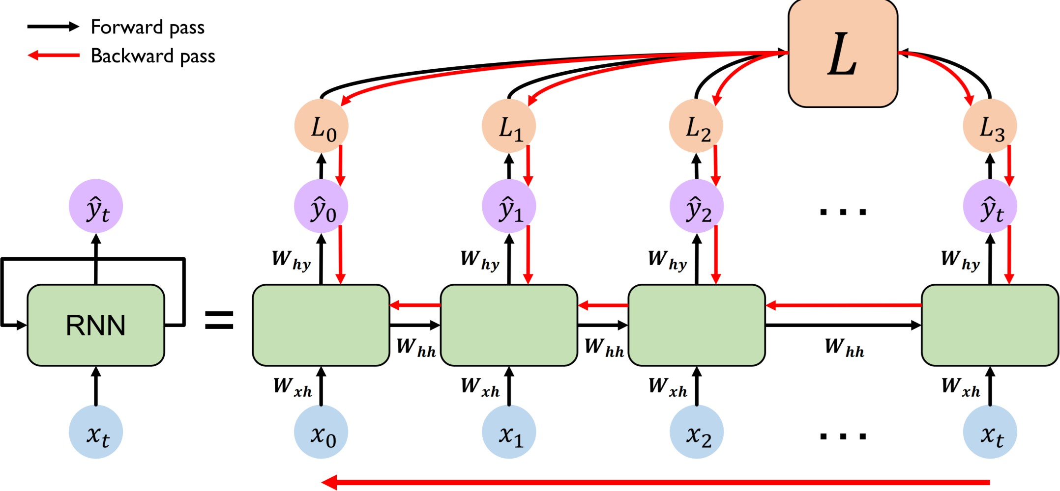
Backpropagation through time

Slide 11
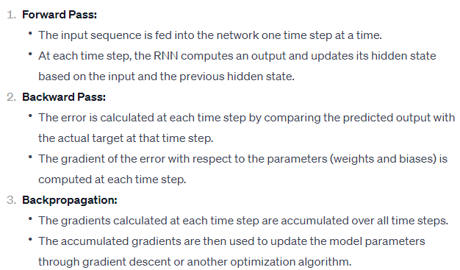
Backpropagation through time

Slide 12
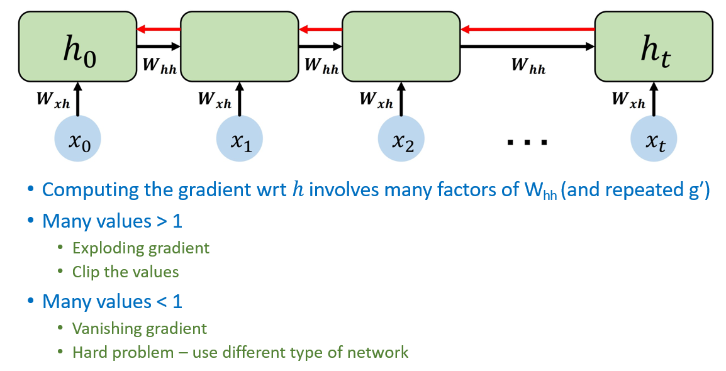
Gradient flow in RNN

Slide 13
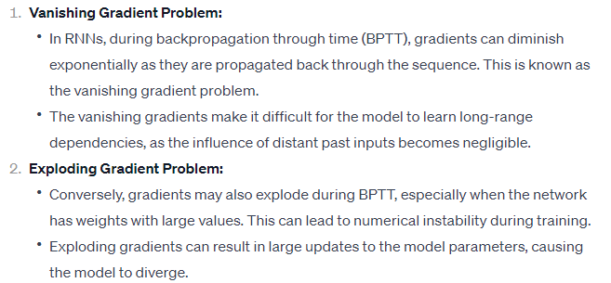
Gradient flow in RNN

Slide 14
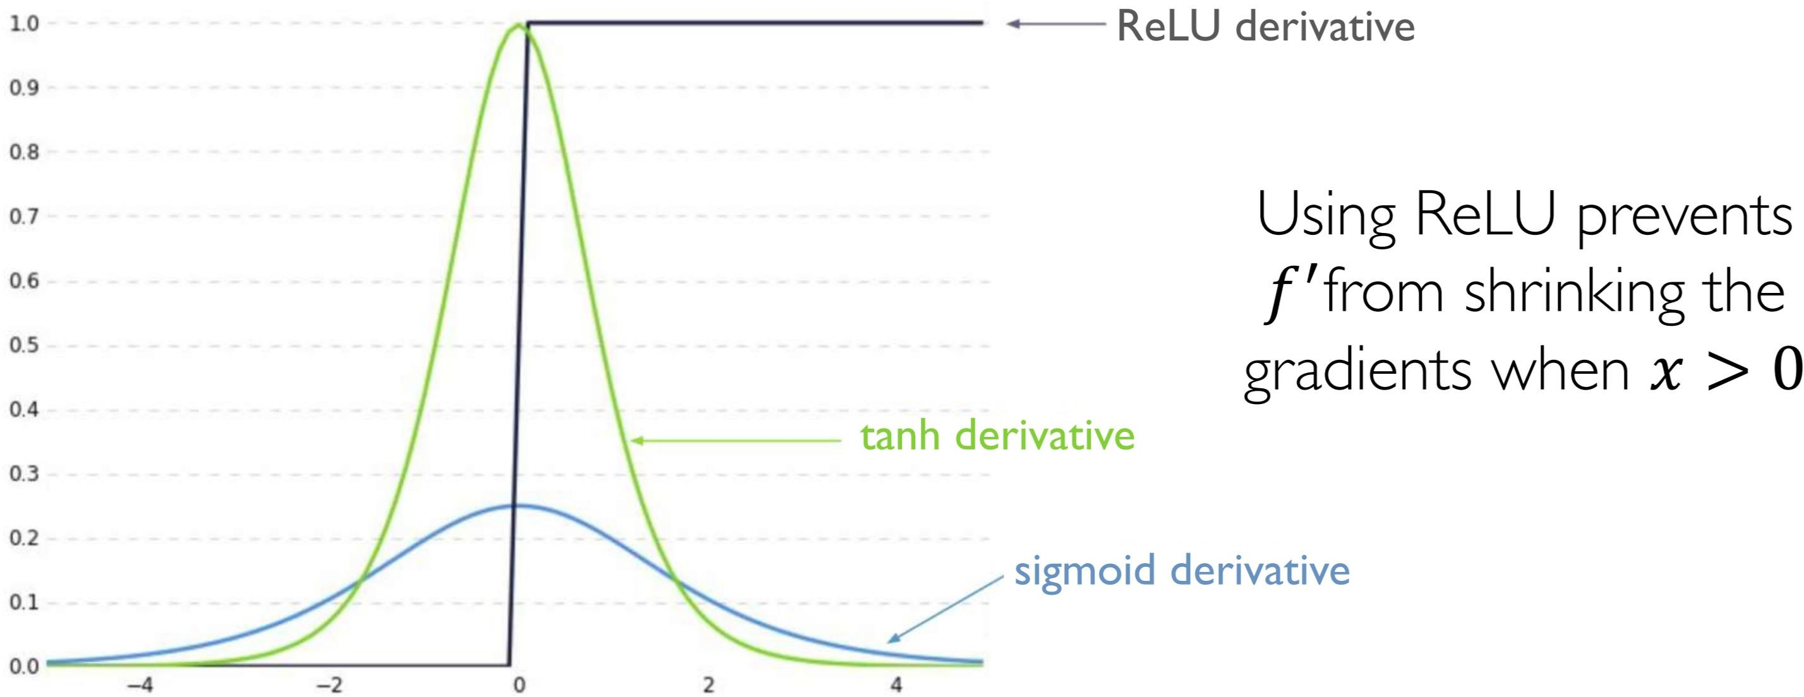
Partial Solution-1

Slide 15
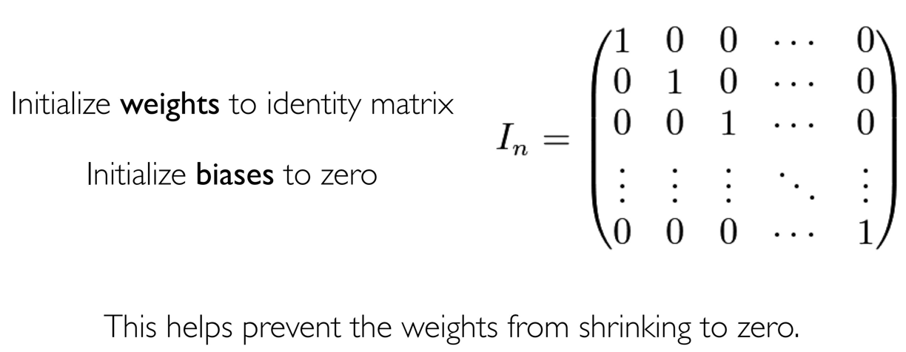
Partial solution 2

Slide 16
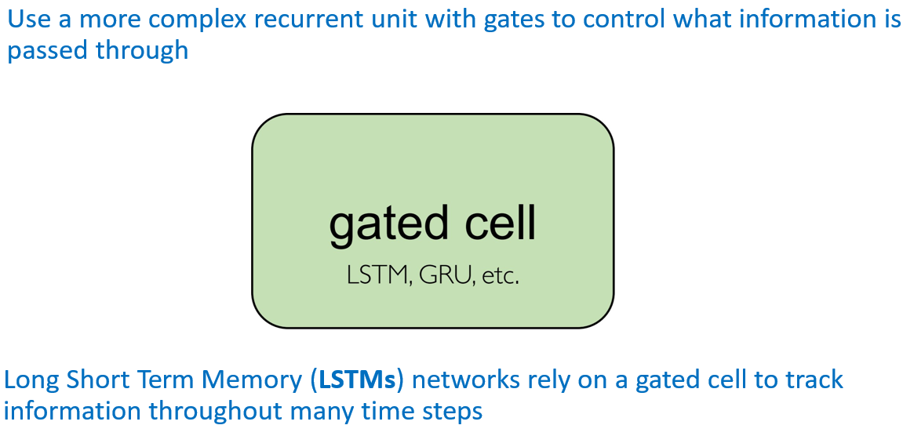
Main Solution – Different kind of units

Slide 17
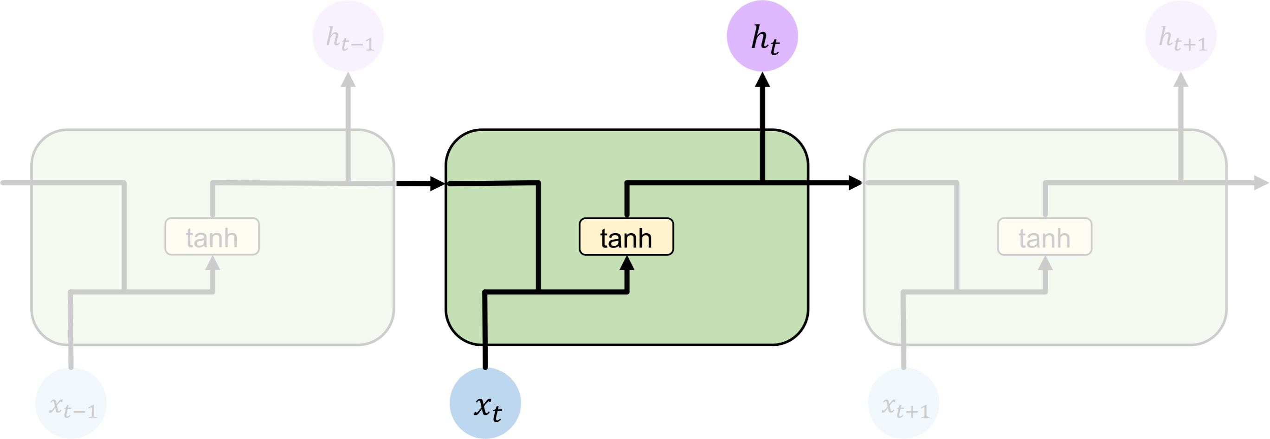
Standard RNN
In standard RNN repeating modules contain a simple computation unit

Slide 18
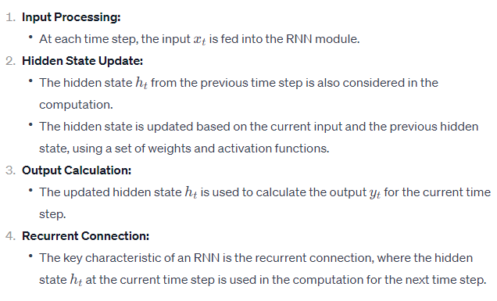
Standard RNN

Slide 19
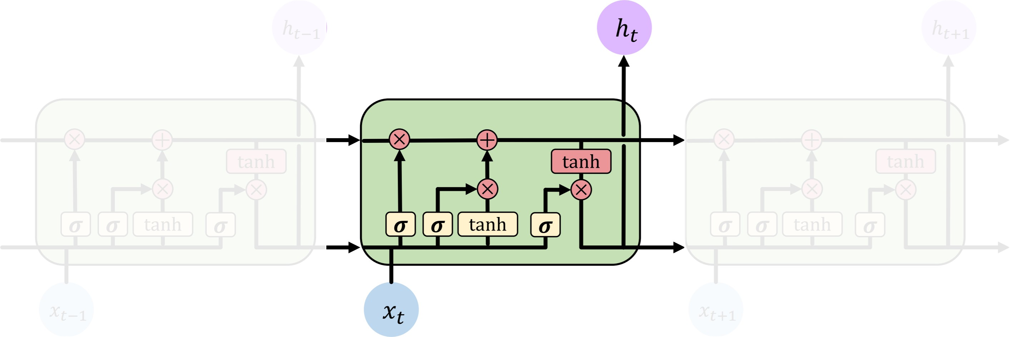
LSTM
LSTM repeating modules contain interacting layers that control information flow
LSTM cells can track information throughout many timesteps

Slide 20
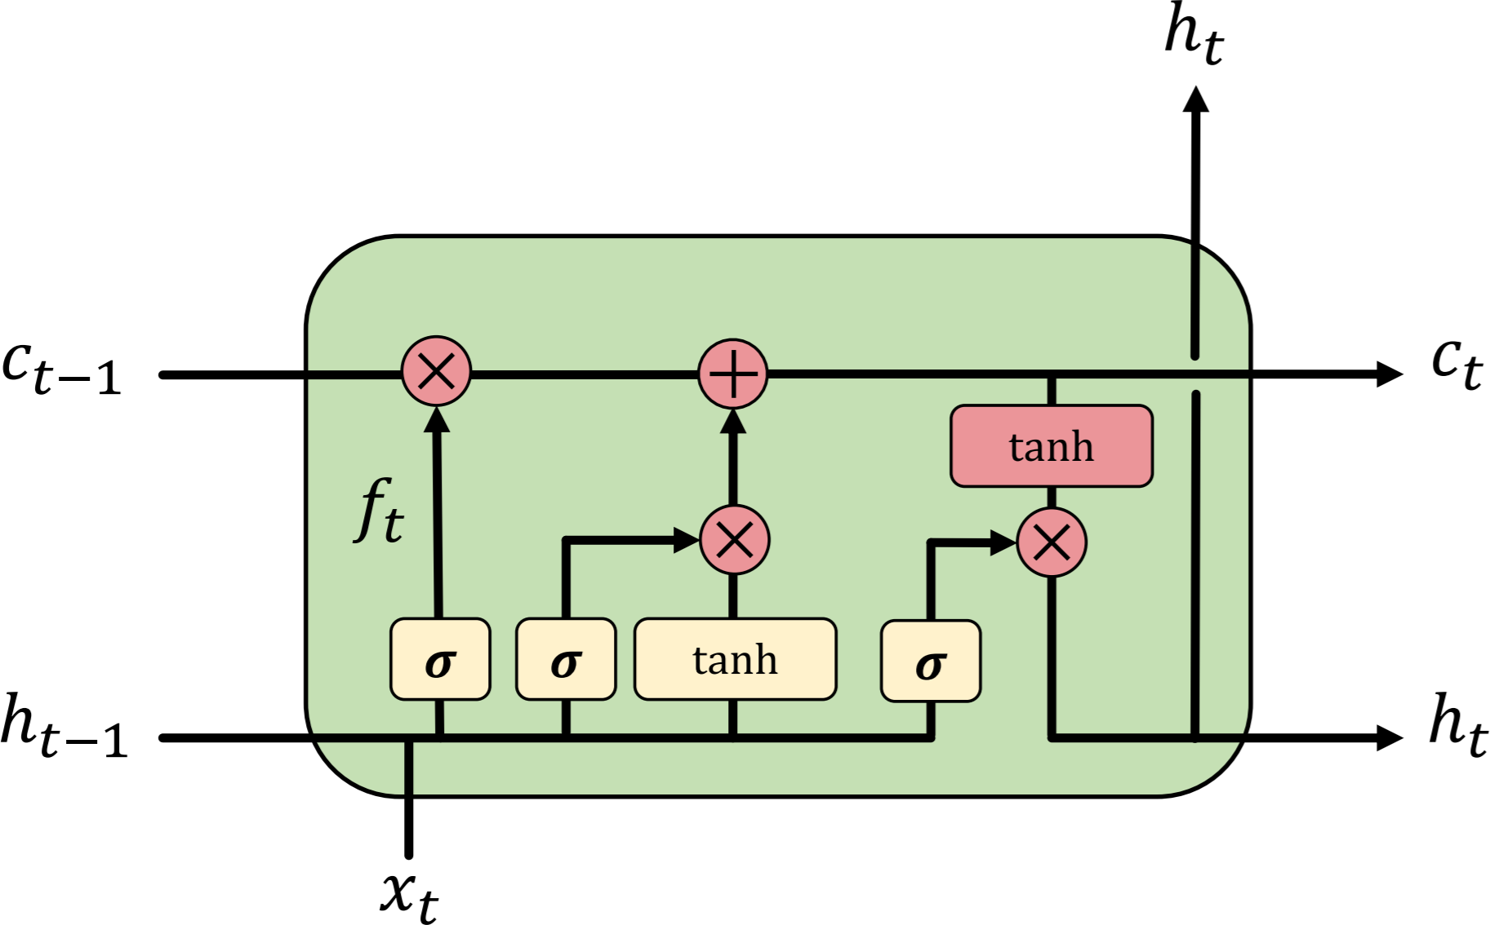
A complete LSTM unit

Slide 21
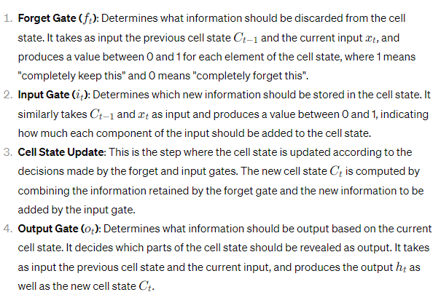
A complete LSTM unit

Slide 22
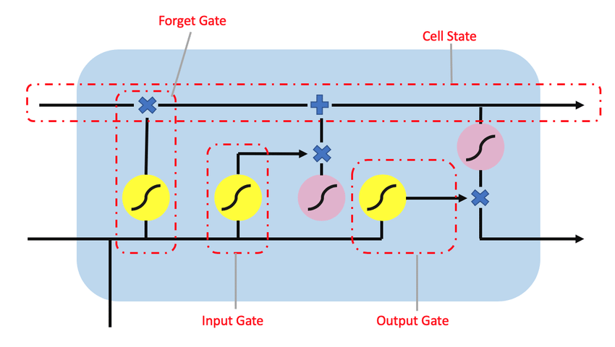
A complete LSTM unit

Slide 23
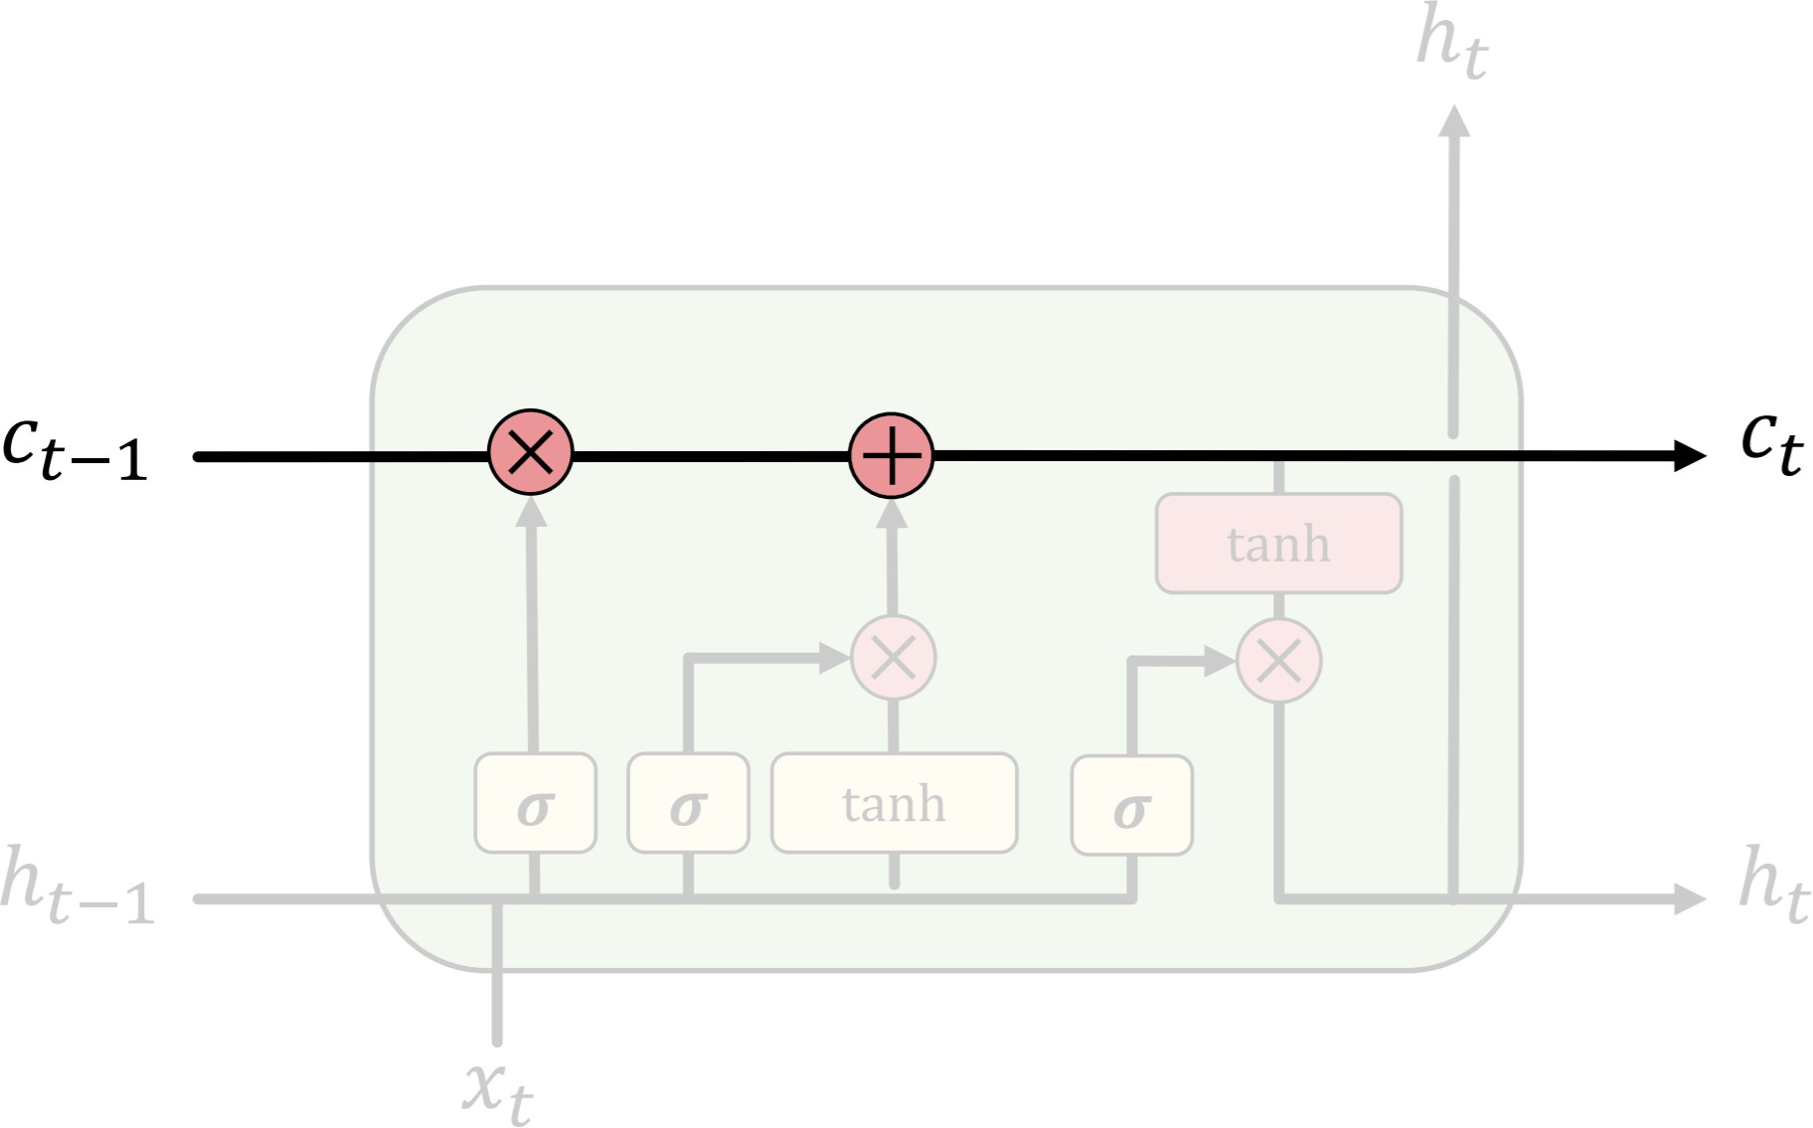
LSTM

Slide 24
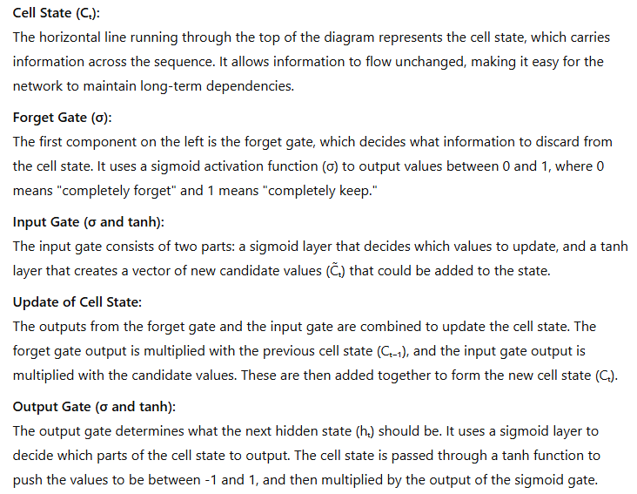
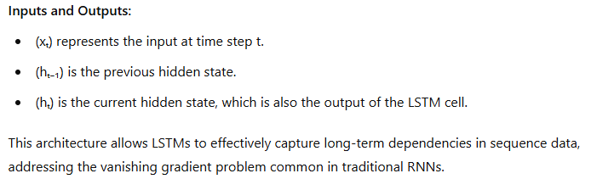
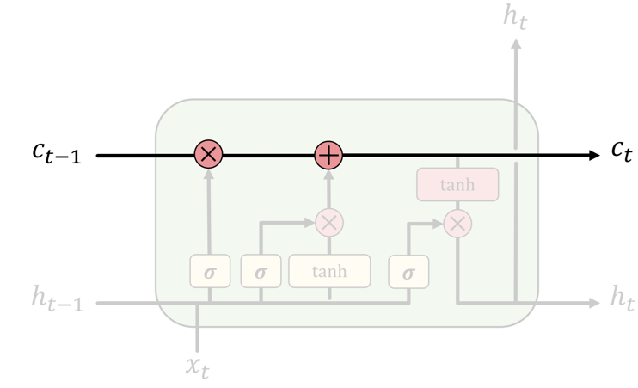
LSTM

Slide 25
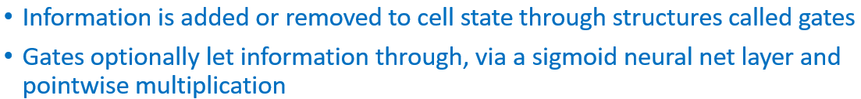
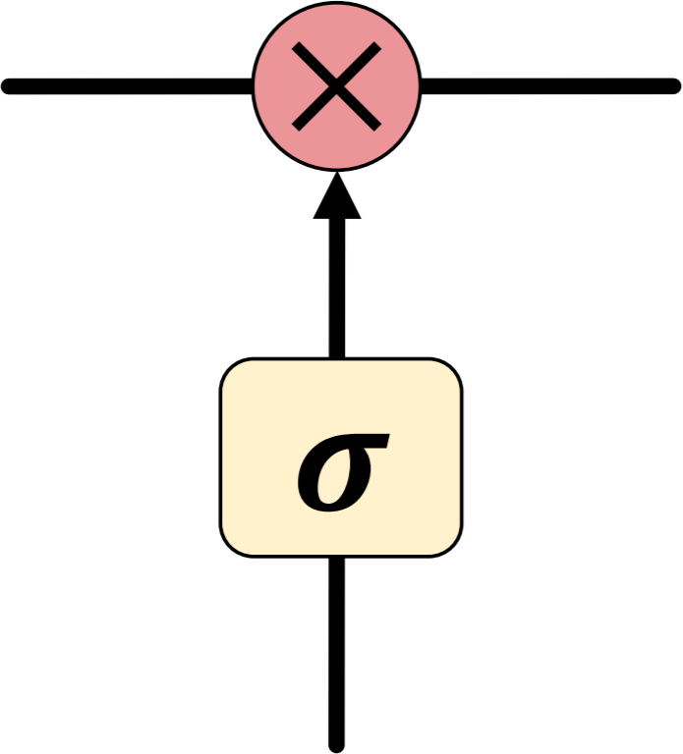
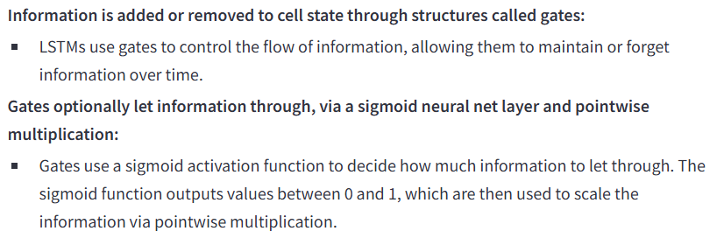
LSTM

Slide 26
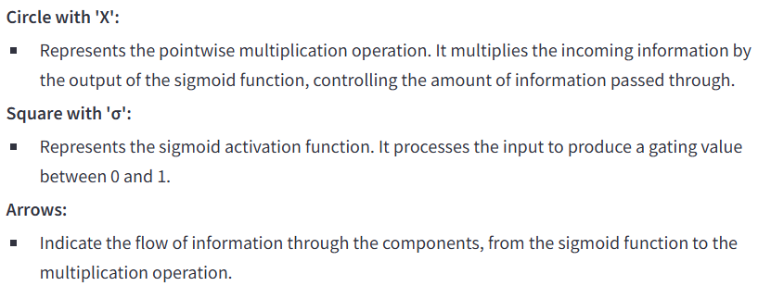
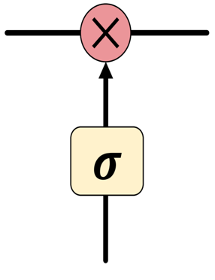
LSTM

Slide 27
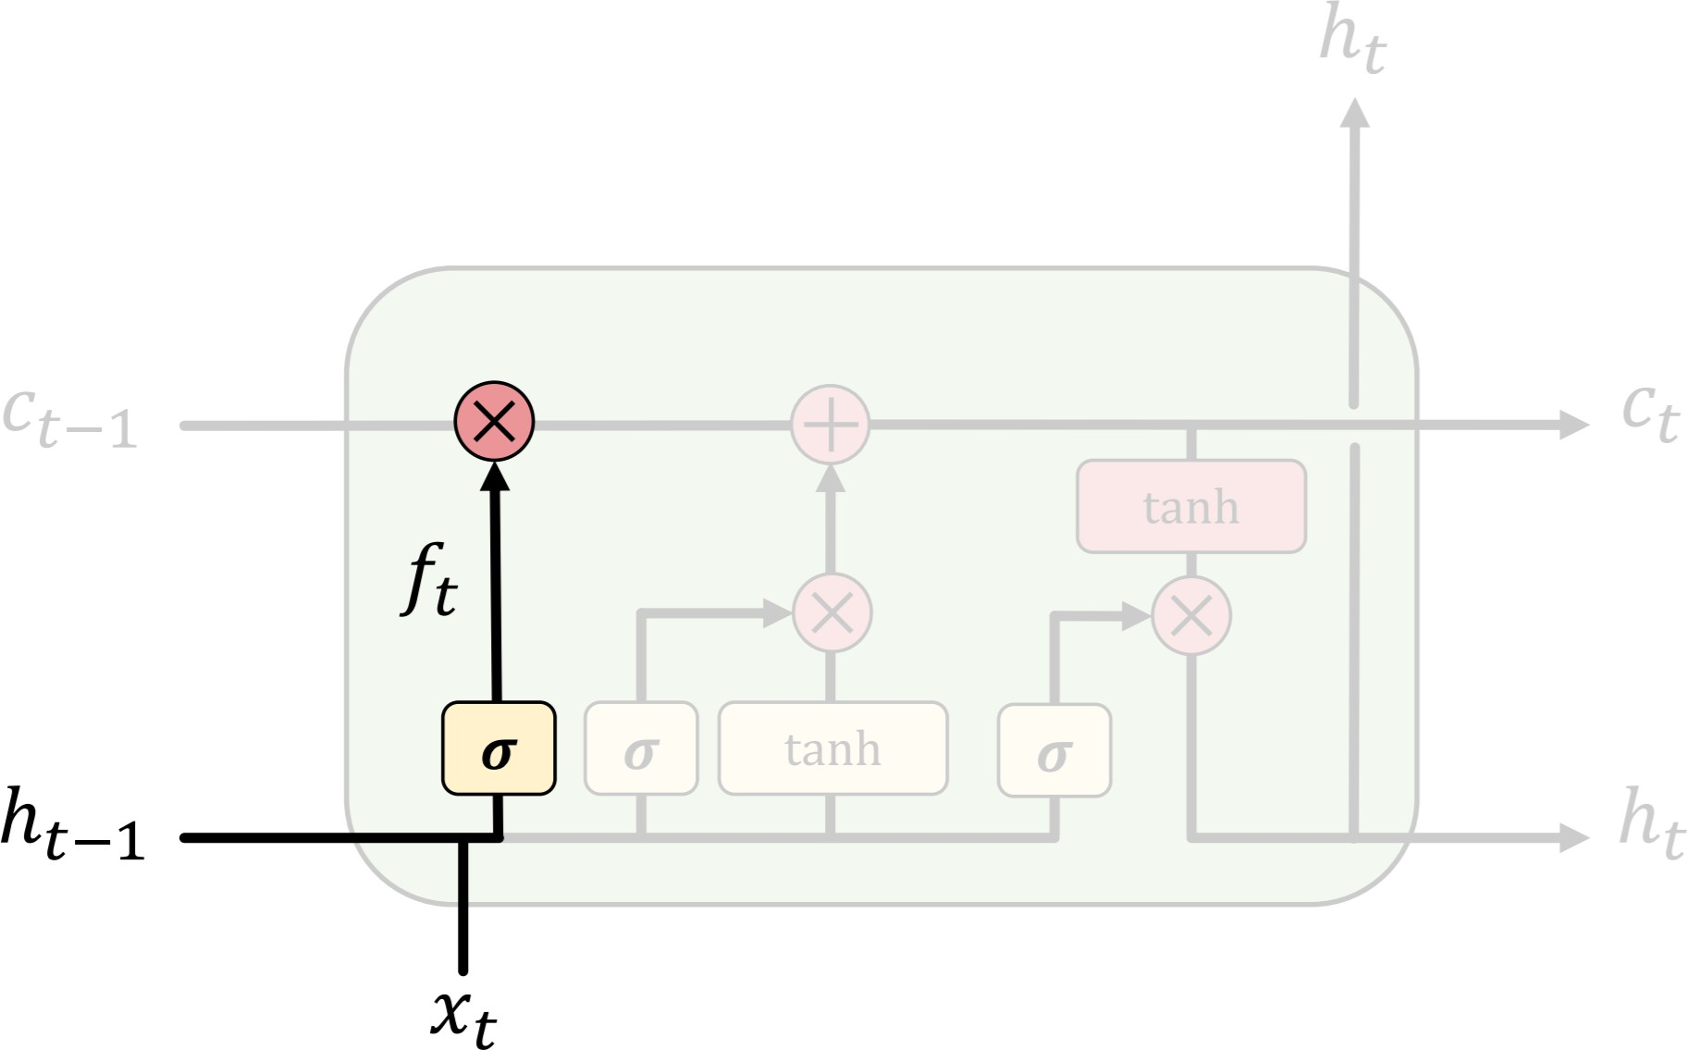
LSTM

Slide 28
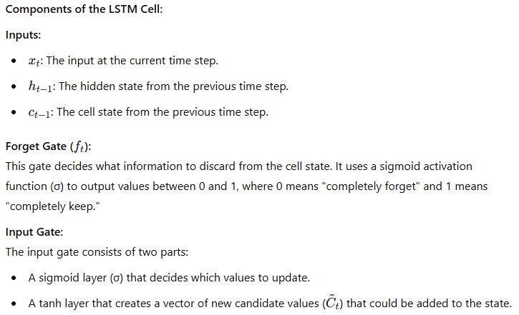
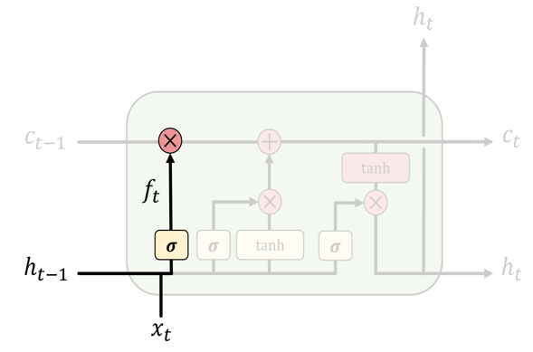
LSTM

Slide 29
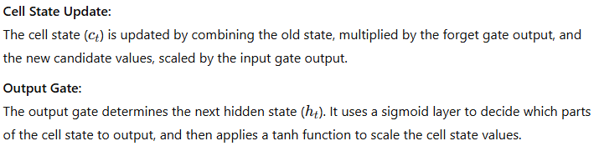
LSTM
Purpose: LSTMs are designed to "forget" irrelevant parts of the previous state. This is particularly useful in tasks like language modeling, where the model needs to remember important information (like subjects) and forget irrelevant details to correctly predict pronouns and other context-dependent elements.

Slide 30
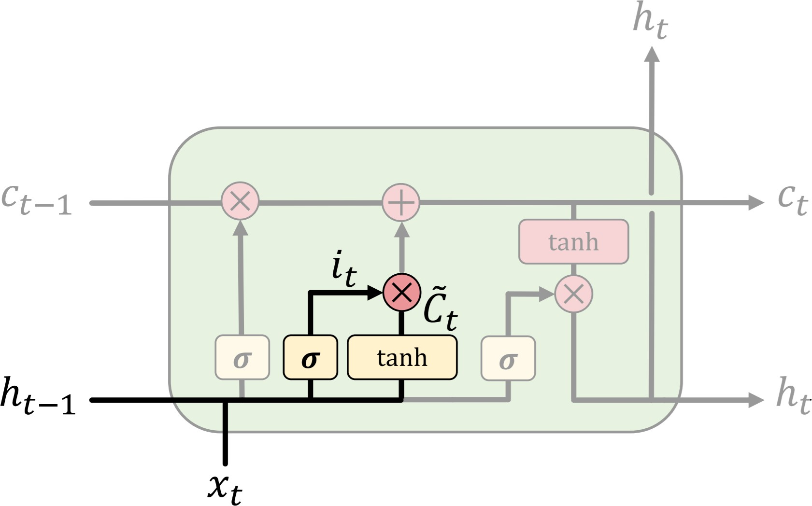
LSTM

Slide 31
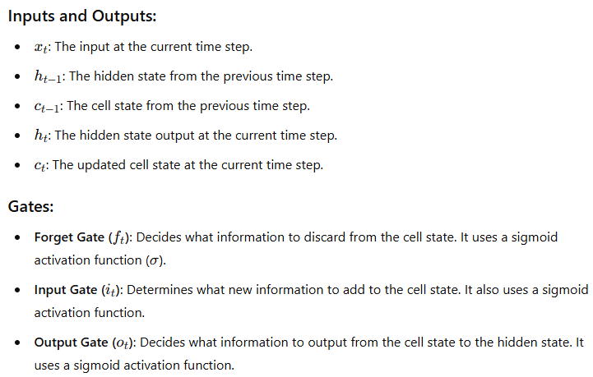
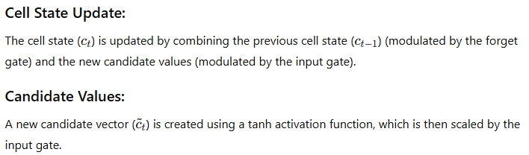
LSTM

Slide 32
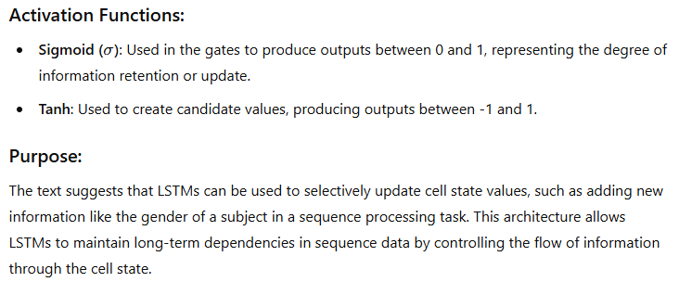
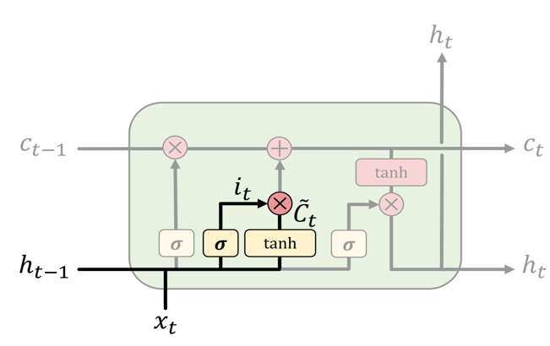
LSTM

Slide 33
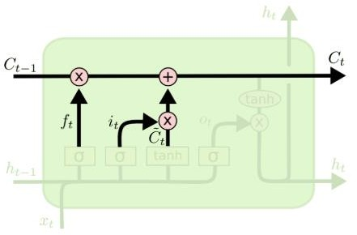
LSTM

Slide 34
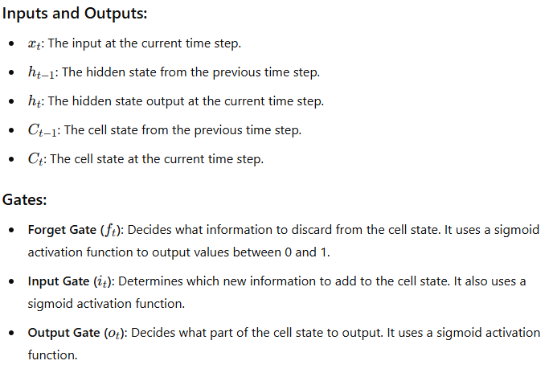
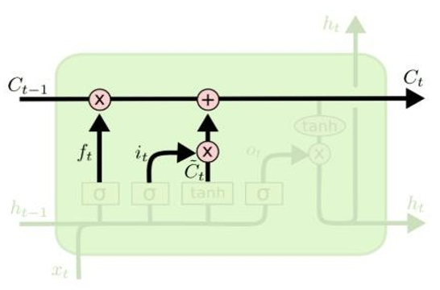
LSTM

Slide 35
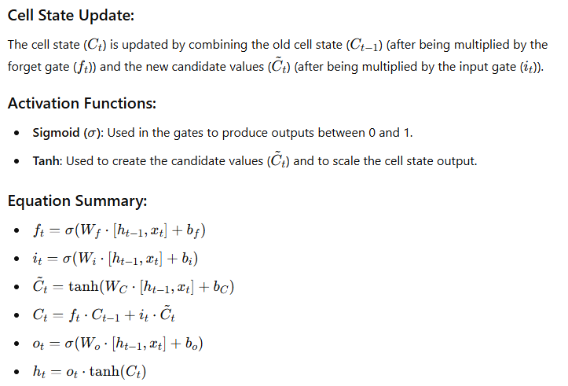
LSTM

Slide 36
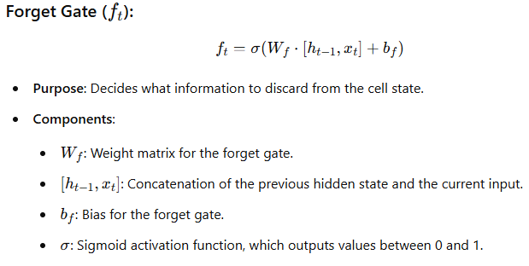
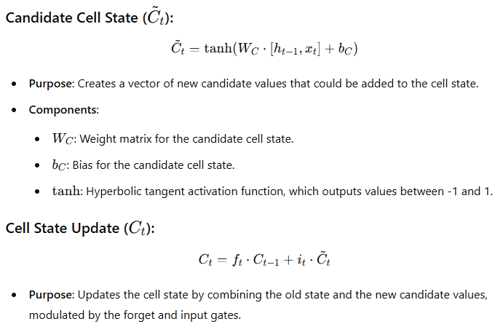
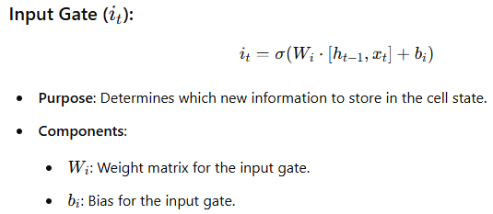
LSTM (Equations)

Slide 37
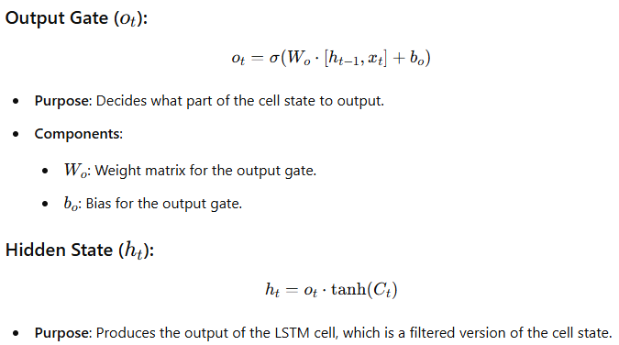
LSTM (Equations)

Slide 38

LSTM

Slide 39

LSTM

Slide 40

LSTM

Slide 41


LSTM

Slide 42

LSTM: Forget irrelevant information

Slide 43

LSTM: Forget irrelevant information

Slide 44

LSTM: Identify new information to store

Slide 45

LSTM: Identify new information to store

Slide 46

LSTM: Update new state

Slide 47


LSTM: Update new state

Slide 48

LSTM: output modified by the memory

Slide 49

LSTM: output modified by the memory

Slide 50

LSTM gradient flow

Slide 51

LSTM gradient flow

Slide 52

LSTM gradient flow

Slide 53
Thank You!!!

